Slide 1
Neural Systems for Fashion-MNIST Classification
Sai Sohan Bhandekar | P2900456

Slide 2
Introduction
The Challenge
Our Focus
Accurate detection of clothing items in photographs is fundamental to computer vision, with applications in online shopping, stock management, and fashion trend analysis.
This project experiments with and compares the performance and overfitting characteristics of different neural architectures on the Fashion-MNIST dataset.
Fashion-MNIST dataset: 28x28 grayscale images across 10 fashion categories.

Slide 3



Project Objectives
Compare Architectures
Analyze Overfitting
Optimize Performance
Evaluate performance differences between ANN and CNN models on fashion image classification.
Identify and measure overfitting patterns across different neural network architectures.
Implement enhancements to improve classification accuracy and reduce confusion between similar classes.

Slide 4



Methodology & Approach
Basic Models
Implement baseline ANN and CNN architectures for initial performance benchmarking.
Enhancement Techniques
Apply Batch Normalization, additional layers, and data augmentation (RandomHorizontalFlip, RandomRotation).
Evaluation
Analyze confusion matrices and accuracy metrics to compare model performance.

Slide 5



Dataset & Materials
Fashion-MNIST Dataset
28x28 grayscale images
Apparel: T-shirt/top, Shirt, Pullover, Coat, Dress
10 fashion categories
Training and test splits
Standardized benchmark dataset
Footwear: Sandal, Sneaker, Ankle boot
Accessories: Bag, Trouser

Slide 6
Implementation Process
Phase 1: Baseline
Phase 3: Enhancement
Trained basic ANN and CNN models to establish performance benchmarks.
Applied Batch Normalization, added layers, implemented data augmentation.
1
2
3
4
Phase 2: Analysis
Phase 4: Validation
Examined confusion matrices to identify problematic class pairs.
Evaluated enhanced models and compared improvements.

Slide 7
Results & Findings
87.69%
91.45%
88.92%
92.02%
Basic ANN
Basic CNN
Enhanced ANN
Enhanced CNN
Baseline accuracy
Baseline accuracy
+3.92% improvement
+2.02% improvement
Model
Accuracy (%)
Loss
Improvement (%)
Enhanced ANN
88.92
0.3049
+3.92
Enhanced CNN
92.02
0.2202
+2.02

Slide 8
Discussion & Interpretation
CNN Superiority
Confusion Patterns
Enhancement Impact
CNN architecture fundamentally better suited for image data due to spatial feature learning through convolutional layers. Enhanced CNN outperformed enhanced ANN by 3.10%.
Both models struggled with visually similar classes: Shirt/Coat/Pullover and T-shirt/Shirt. Enhanced CNN showed lower confusion for most difficult pairs, especially footwear categories.
Data augmentation and Batch Normalization proved effective. ANN showed larger relative improvement (+3.92%) while CNN maintained superior absolute performance.

Slide 9
Conclusion
92.02%
Key Achievements
Successfully compared ANN vs CNN architectures
Demonstrated effectiveness of data augmentation and Batch Normalization
Enhanced CNN achieved best performance on Fashion-MNIST dataset
Reduced confusion between visually similar clothing items
Established CNN as superior choice for fashion image classification

Slide 10
Future Work & Recommendations
Advanced Architectures
Hyperparameter Tuning
Explore ResNet, VGG, and other sophisticated CNN architectures for potential performance gains.
Optimize enhanced CNN model through systematic hyperparameter exploration.
Targeted Improvements
Enhanced Augmentation
Apply hard negative mining or sophisticated loss functions for confused classes (Shirt/T-shirt/Coat/Pullover).
Test more sophisticated data augmentation techniques to further improve generalization.

Slide 11
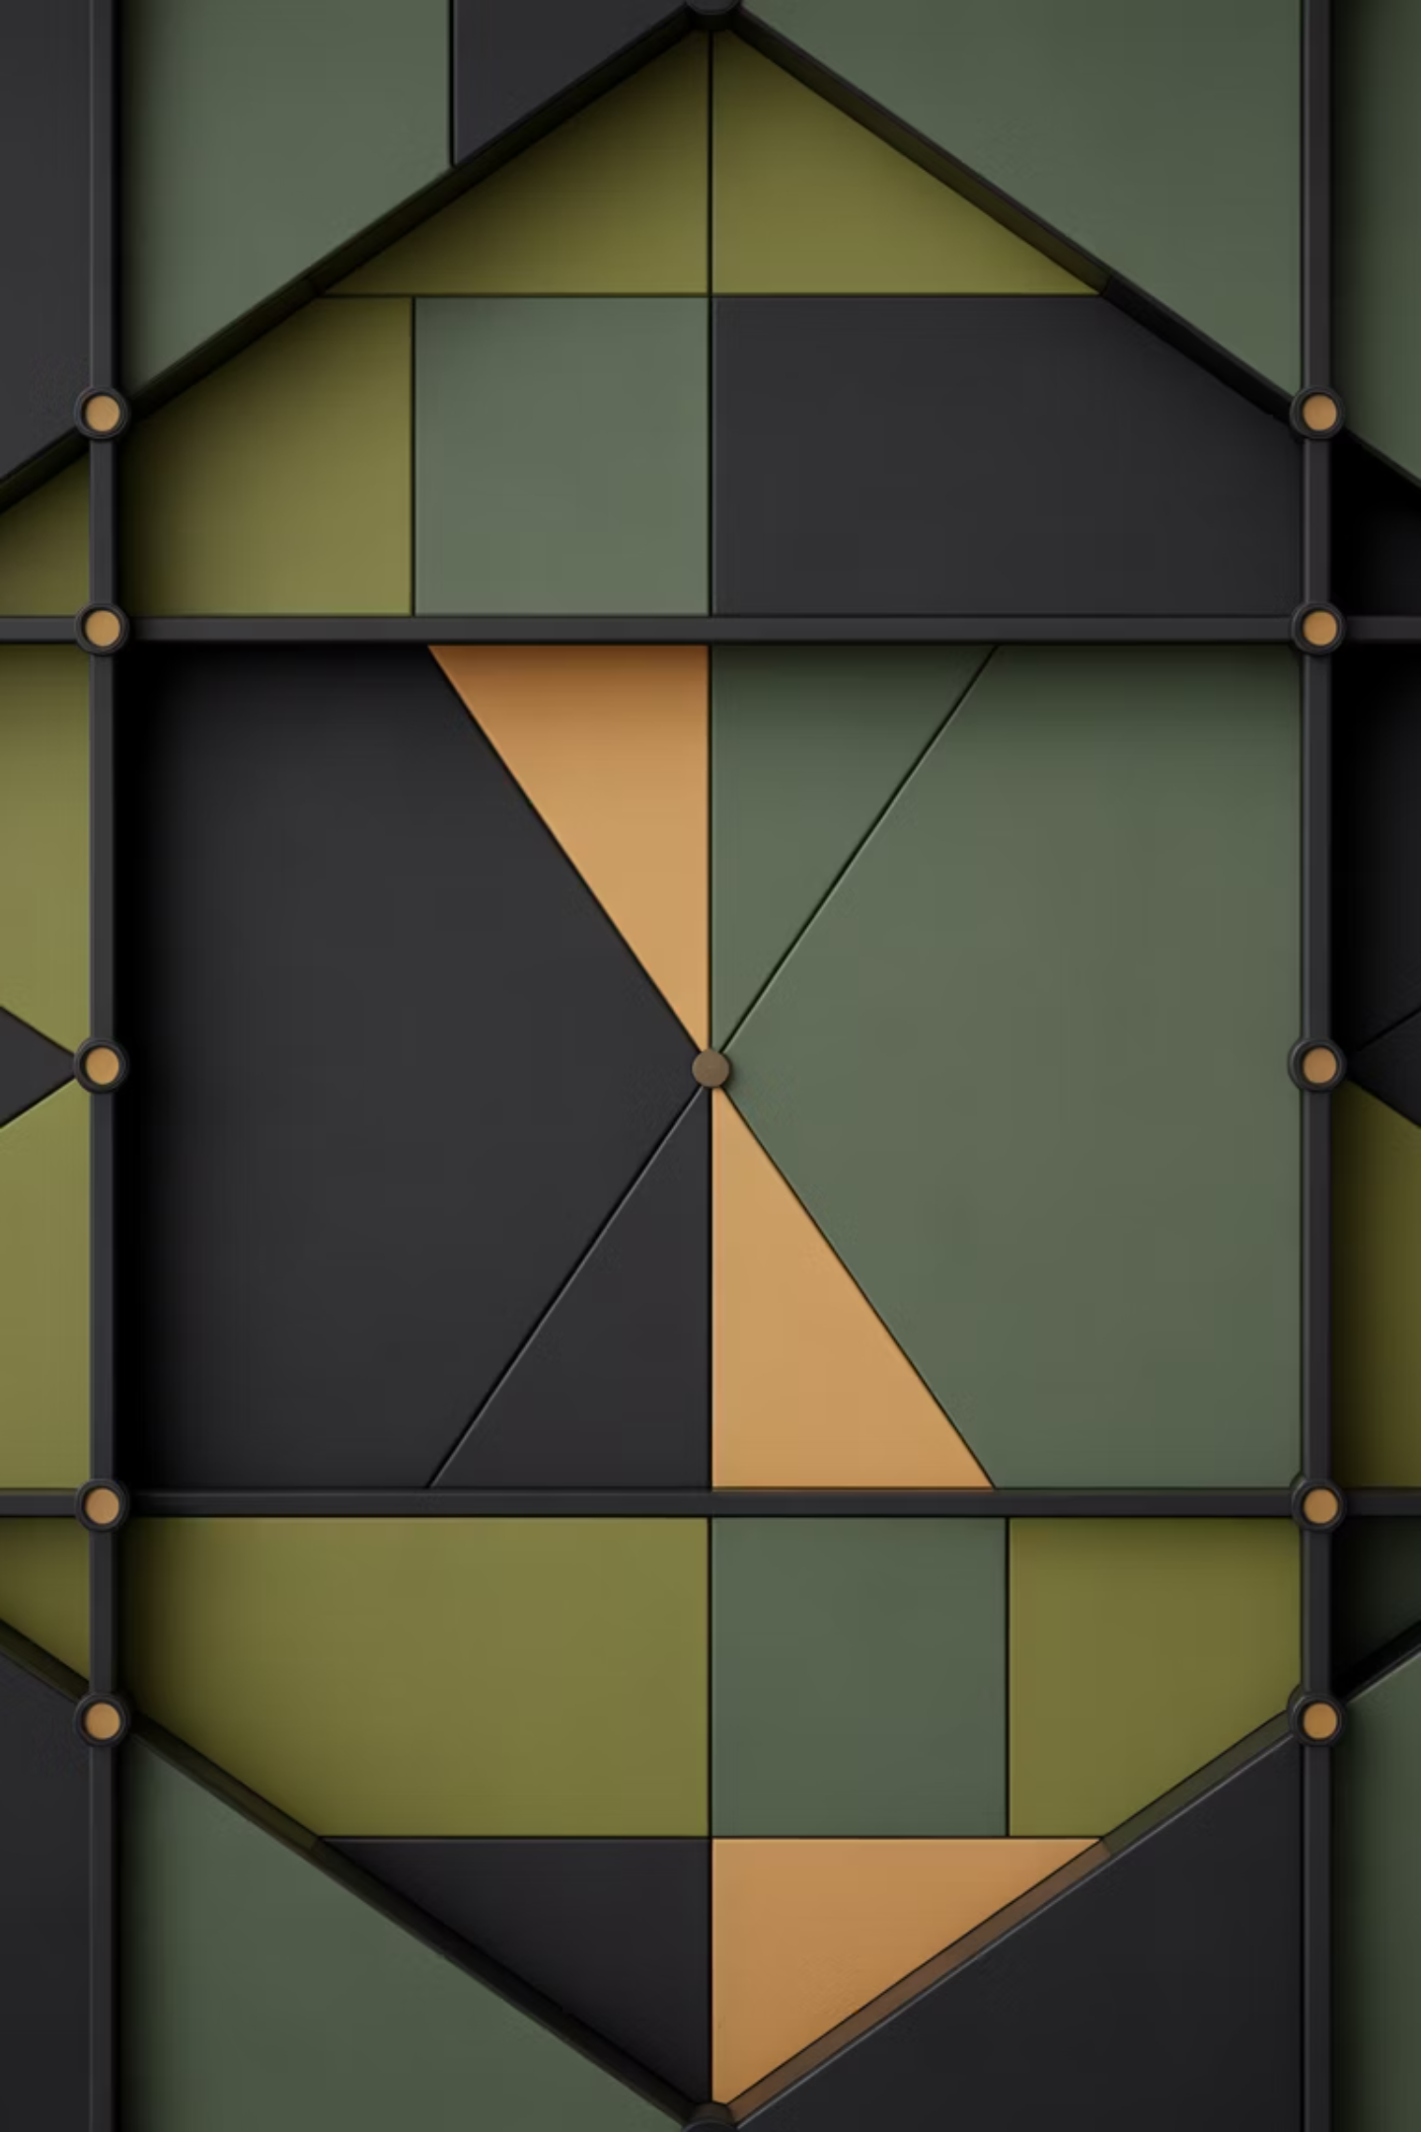
Thank You
Questions & Discussion Welcome

